Slide 1

Slides for Chapter 7:
Operating System support
From Coulouris, Dollimore, Kindberg and Blair
Distributed Systems:
Concepts and Design
Edition 5, © Addison-Wesley 2012

Slide 2
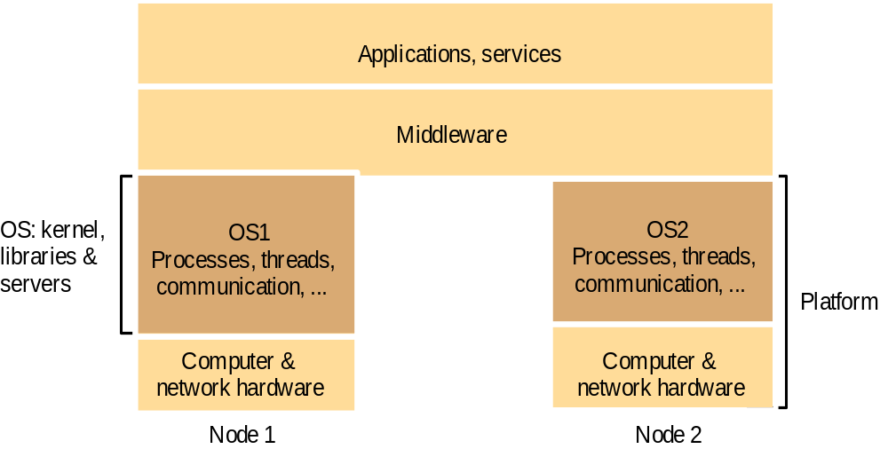
Figure 7.1
System layers
Instructor’s Guide for Coulouris, Dollimore, Kindberg and Blair, Distributed Systems: Concepts and Design Edn. 5
© Pearson Education 2012

Slide 3
Kernels and server processes are the components that manage resources and present clients with an interface to the resources.
It requires:
Encapsulation: They should provide a useful service interface to their resources – Details such as management of memory and devices used to implement resources should be hidden from clients.
2. Protection: Resources require protection from illegitimate accesses – for example, files are protected from being read by users without read permissions, and device registers are protected from application processes.
3. Concurrent processing: Clients may share resources and access them concurrently.

Slide 4
A combination of libraries, kernels and servers may be called upon to perform the following invocation
Communication: Operation parameters and results have to be passed to and from resource managers, over a network or within a computer.
Scheduling: When an operation is invoked, its processing must be scheduled within the kernel or server.

Slide 5
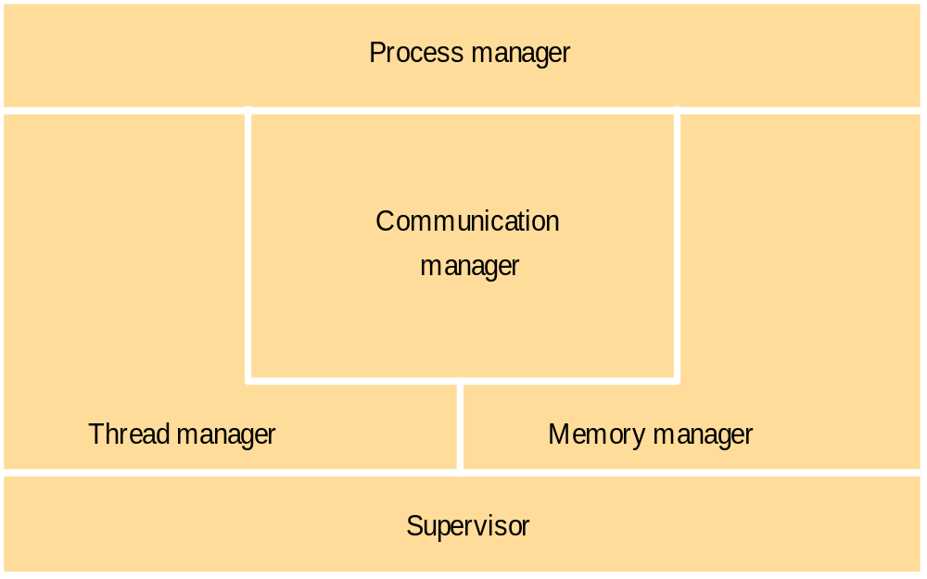
Figure 7.2
Core OS functionality
Instructor’s Guide for Coulouris, Dollimore, Kindberg and Blair, Distributed Systems: Concepts and Design Edn. 5
© Pearson Education 2012

Slide 6
The core OS components and their responsibilities are:
Process manager: Creation of and operations upon processes. A process is a
unit of resource management, including an address space and one or more
threads.
Thread manager: Thread creation, synchronization and scheduling. Threads
are schedulable activities attached to processes.
Communication manager: Communication between threads attached to
Different processes on the same computer. Some kernels also support
communication between threads in remote processes. Other kernels have no
notion of other computers built into them, and an additional service is required
for external communication
Memory manager: Management of physical and virtual memory.
Supervisor: Dispatching of interrupts, system call traps and other exceptions;
Control of memory management unit and hardware caches; processor and
floating-point unit register manipulations. This is known as the Hardware
Abstraction Layer in Windows

Slide 7
Process and Threads
A thread is the operating system abstraction of an activity.
An execution environment is the unit of resource management: a collection of local kernel managed resources to which its threads have access. An execution environment primarily consists of:
• an address space;
• thread synchronization and communication resources such as semaphores and communication interfaces.
• higher-level resources such as open files and windows.
Execution environments are normally expensive to create and manage, but several threads can share them – that is, they can share all resources accessible within them

Slide 8
An execution environment provides protection from threads outside it.
so that the data and other resources contained in it are by default inaccessible to threads residing in other execution environments.
But certain kernels allow the controlled sharing of resources such as physical memory between execution environments residing at the same compute

Slide 9
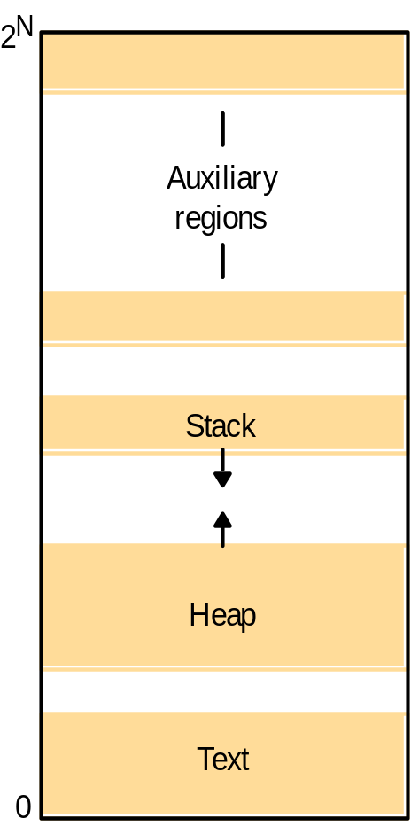
Figure 7.3
Address space
Instructor’s Guide for Coulouris, Dollimore, Kindberg and Blair, Distributed Systems: Concepts and Design Edn. 5
© Pearson Education 2012

Slide 10
It is large (typically up to 232 bytes, and sometimes up to 264 bytes)
consists of one or more regions, separated by inaccessible areas of virtual memory.
A region is an area of contiguous virtual memory that is accessible by the threads of the owning process.
Regions do not overlap.
Properties of region:
• its extent (lowest virtual address and size);
• read/write/execute permissions for the process’s threads;
• whether it can be grown upwards or downwards

Slide 11
Regions, unlike segments, would eventually overlap if they were extended in size. Gaps are left.
Three regions:
A fixed, unmodifiable text region containing program code;
a heap, part of which is initialized by values stored in the program’s binary file, and which is extensible towards higher virtual addresses;
stack, which is extensible towards lower virtual addresses.

Slide 12
Creation of new process
The UNIX fork system call creates a process with an execution environment copied from the caller (except for the return value from fork).
The UNIX exec system call transforms the calling process into one executing the code of a named program.
The creation of a new process can be separated into two independent aspects:
• The choice of a target host, for example, the host may be chosen from among the nodes in a cluster of computers acting as a compute server.
• The creation of an execution environment.

Slide 13
Choice of process host
process allocation policies range from always running new processes at their originator’s workstation to sharing the processing load between a set of computers.
two policy categories for load sharing.
The transfer policy: determines whether to situate a new process
locally or remotely. This may depend, for example, on whether the local
node is lightly or heavily loaded.
The location policy :determines which node should host a new process
selected for transfer. This decision may depend on the relative loads of
nodes, on their Machine architectures or on any specialized resources
they may possess

Slide 14
Process location policies may be static or Adaptive.
The former operate without regard to the current state of the system.
Deterministic (‘node A should always transfer processes to node B’)
Probabilistic (‘node A should transfer processes to any of nodes B–E at random’).
Adaptive policies, on the other hand, apply heuristics to make their allocation decisions, based on unpredictable runtime factors such as a measure of the load on each node.

Slide 15
Load-sharing systems may be centralized, hierarchical or decentralized.
In centralized, there is one load manager component.
In the hierarchical,
  there are several, organized in a tree structure.
  Load managers collect information about the nodes and use it to allocate new processes to nodes. managers make process allocation decisions .
Managers may transfer processes to one another, via a common ancestor, under certain load conditions.

Slide 16
In a decentralized load-sharing system, nodes exchange information with one another directly to make allocation decisions

Slide 17
In sender-initiated load-sharing algorithms, the node that requires a new process to be created is responsible for initiating the transfer decision. It typically initiates a transfer when its own load crosses a threshold.
By contrast, in receiver-initiated algorithms, a node whose load is below a given threshold advertises its existence to other nodes so that relatively loaded nodes can transfer work to it.

Slide 18
Migratory load-sharing systems can shift load at any time, not just when a new process is created. They use a mechanism called process migration: the transfer of an executing process from one node to another

Slide 19
Creation of new execution environment
new process requires an execution environment consisting of an address space with initialized contents.
Two approaches for defining address space:
The first approach is used where the address space is of a statically defined format. For example, it could contain just a program text region, heap region and stack region.
In this case, the address space regions are created from a list specifying their extent.

Slide 20
Alternatively, the address space can be defined with respect to an existing execution environment.
In the case of UNIX fork semantics, for example, the newly created child process physically shares the parent’s text region and has heap and stack regions that are copies of the parent’s in extent

Slide 21
Figure 7.4
Copy-on-write
Process A’s address space
Process B’s address space
RB copied
RA
from RA
RB
Kernel
Shared
A's page
frame
B's page
table
table
a) Before write
b) After write
Instructor’s Guide for Coulouris, Dollimore, Kindberg and Blair, Distributed Systems: Concepts and Design Edn. 5
© Pearson Education 2012

Slide 22
copy-on-write when an inherited region is copied from the parent.
The region is copied, but no physical copying takes place by default.
The page frames that make up the inherited region are shared between the two address spaces.
A page in the region is only physically copied when one or another process attempts to modify it.

Slide 23
Figure 7.5
Client and server with threads
Thread 2 makes
requests to server
Input-output
Receipt &
Thread 1
queuing
generates
results
T1
Requests
N threads
Client
Server
Instructor’s Guide for Coulouris, Dollimore, Kindberg and Blair, Distributed Systems: Concepts and Design Edn. 5
© Pearson Education 2012

Slide 24
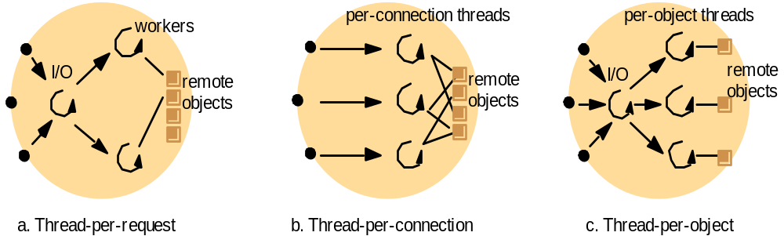
Figure 7.6
Alternative server threading architectures (see also Figure 7.5)
Instructor’s Guide for Coulouris, Dollimore, Kindberg and Blair, Distributed Systems: Concepts and Design Edn. 5
© Pearson Education 2012

Slide 25
Figure 7.7
State associated with execution environments and threads
Execution environment
Thread
Address space tables
Saved processor registers
Communication interfaces, open files
Priority and execution state (such as
BLOCKED)
Semaphores, other synchronization
Software interrupt handling information
objects
List of thread identifiers
Execution environment identifier
Pages of address space resident in memory; hardware cache entries
Instructor’s Guide for Coulouris, Dollimore, Kindberg and Blair, Distributed Systems: Concepts and Design Edn. 5
© Pearson Education 2012

Slide 26
Figure 7.8
Java thread constructor and management methods
Thread(ThreadGroup group, Runnable target, String name)
Creates a new thread in the SUSPENDED state, which will belong to group and be identified as name; the thread will execute the run() method of target.
setPriority(int newPriority), getPriority()
Set and return the thread’s priority.
run()
A thread executes the run() method of its target object, if it has one, and otherwise its own run() method (Thread implements Runnable).
start()
Change the state of the thread from SUSPENDED to RUNNABLE.
sleep(int millisecs)
Cause the thread to enter the SUSPENDED state for the specified time.
yield()
Causes the thread to enter the READY state and invoke the scheduler.
destroy()
Destroy the thread.
Instructor’s Guide for Coulouris, Dollimore, Kindberg and Blair, Distributed Systems: Concepts and Design Edn. 5
© Pearson Education 2012

Slide 27
Figure 7.9
Java thread synchronization calls
thread.join(int millisecs)
Blocks the calling thread for up to the specified time until thread has terminated.
thread.interrupt()
Interrupts thread: causes it to return from a blocking method call such as sleep().
object.wait(long millisecs, int nanosecs)
Blocks the calling thread until a call made to notify() or notifyAll() on object wakes the thread, or the thread is interrupted, or the specified time has elapsed.
object.notify(), object.notifyAll()
Wakes, respectively, one or all of any threads that have called wait() on object.
Instructor’s Guide for Coulouris, Dollimore, Kindberg and Blair, Distributed Systems: Concepts and Design Edn. 5
© Pearson Education 2012

Slide 28
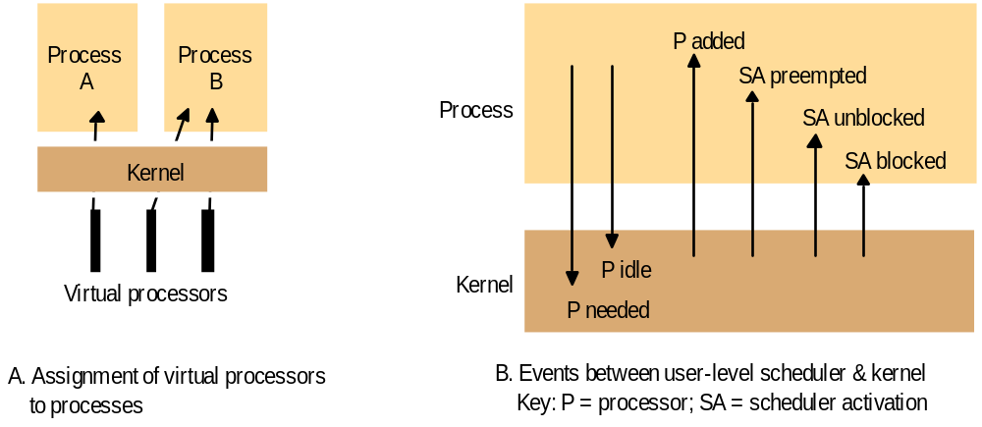
Figure 7.10
Scheduler activations
Instructor’s Guide for Coulouris, Dollimore, Kindberg and Blair, Distributed Systems: Concepts and Design Edn. 5
© Pearson Education 2012

Slide 29
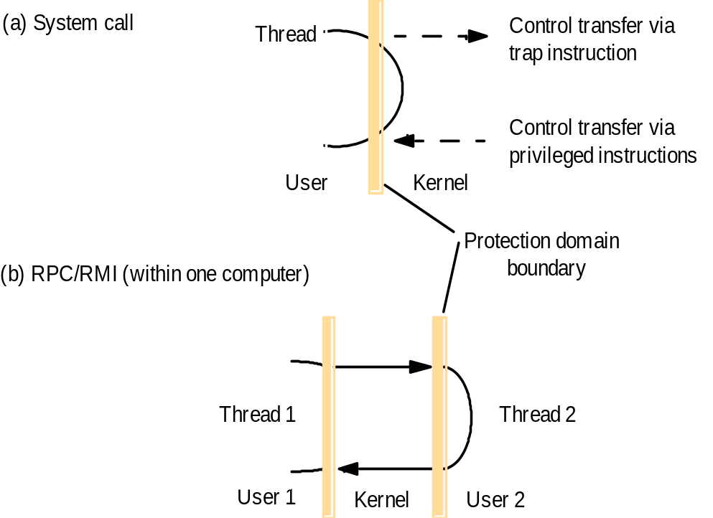
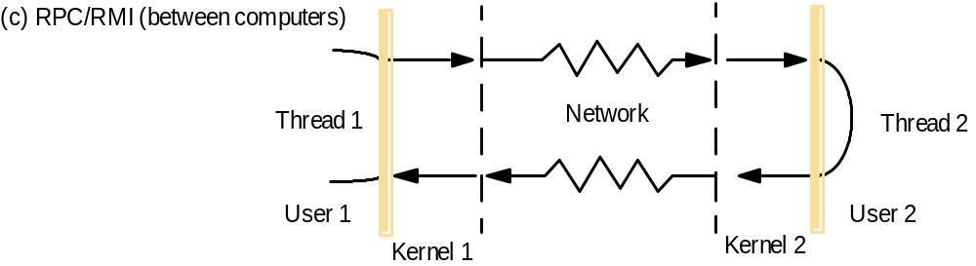
Figure 7.11
Invocations between address spaces
Instructor’s Guide for Coulouris, Dollimore, Kindberg and Blair, Distributed Systems: Concepts and Design Edn. 5
© Pearson Education 2012

Slide 30
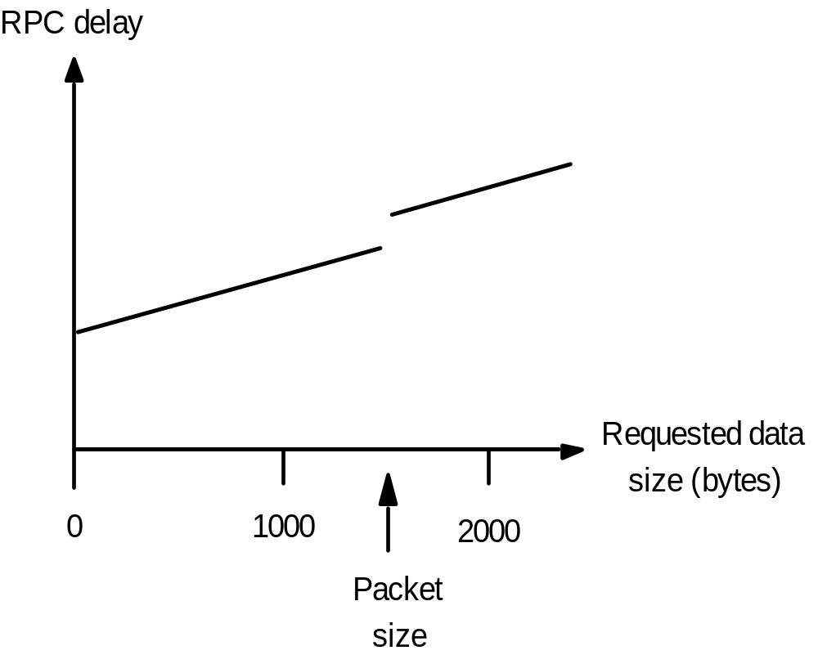
Figure 7.12
RPC delay against parameter size
Instructor’s Guide for Coulouris, Dollimore, Kindberg and Blair, Distributed Systems: Concepts and Design Edn. 5
© Pearson Education 2012

Slide 31
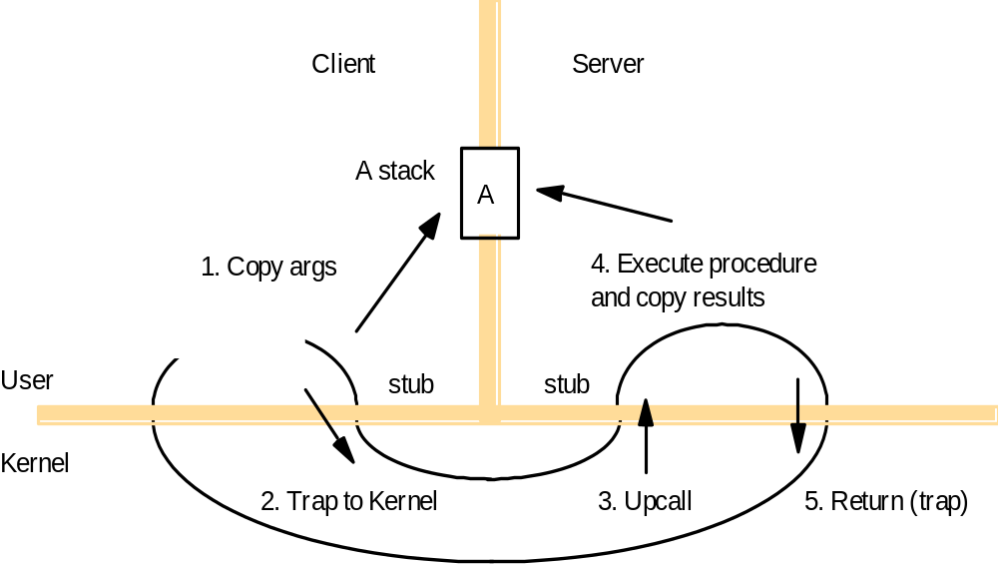
Figure 7.13
A lightweight remote procedure call
Instructor’s Guide for Coulouris, Dollimore, Kindberg and Blair, Distributed Systems: Concepts and Design Edn. 5
© Pearson Education 2012

Slide 32
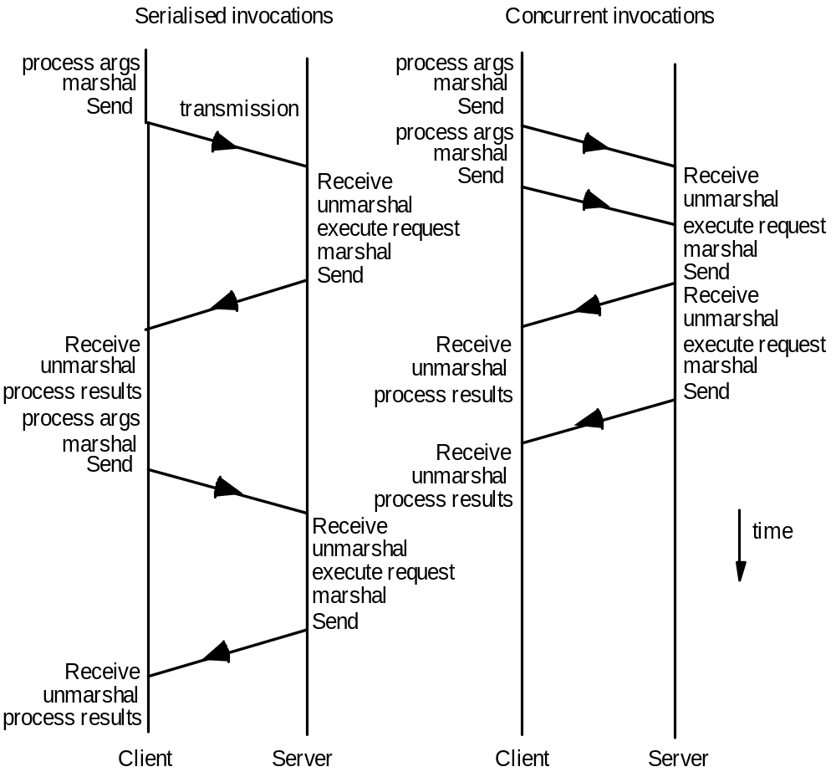
Figure 7.14
Times for serialized and concurrent invocations
Instructor’s Guide for Coulouris, Dollimore, Kindberg and Blair, Distributed Systems: Concepts and Design Edn. 5
© Pearson Education 2012

Slide 33
Operating system architecture
Monolithic kernels:
The UNIX operating system kernel has been called monolithic .
It is massive: it performs all basic operating system functions and takes up in the order of megabytes of code and data
it is undifferentiated: it is coded in a non-modular way.
It is intractable: altering any individual software component to adapt it to
changing requirements is difficult.
microkernel :
Provides only the most basic abstractions, principally address spaces, threads and local interprocess communication;
all other system services are provided by servers that are dynamically loaded at computers in the distributed system that require them.
Clients access these system services using the kernel’s message-based invocation mechanisms

Slide 34
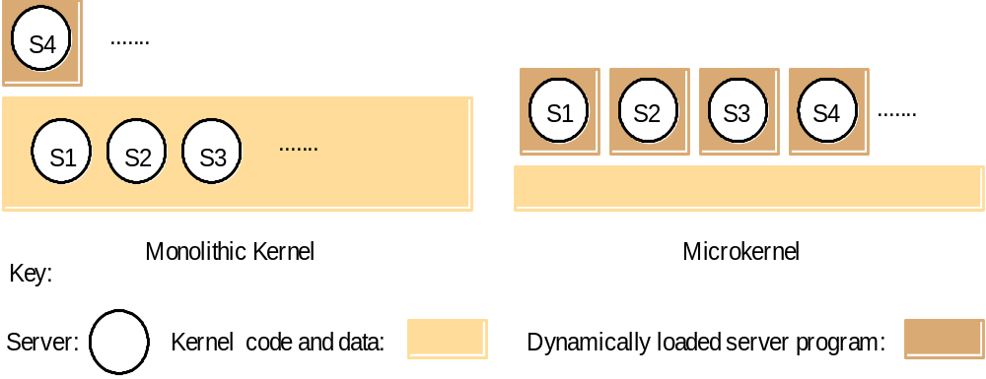
Figure 7.15
Monolithic kernel and microkernel
Instructor’s Guide for Coulouris, Dollimore, Kindberg and Blair, Distributed Systems: Concepts and Design Edn. 5
© Pearson Education 2012

Slide 35
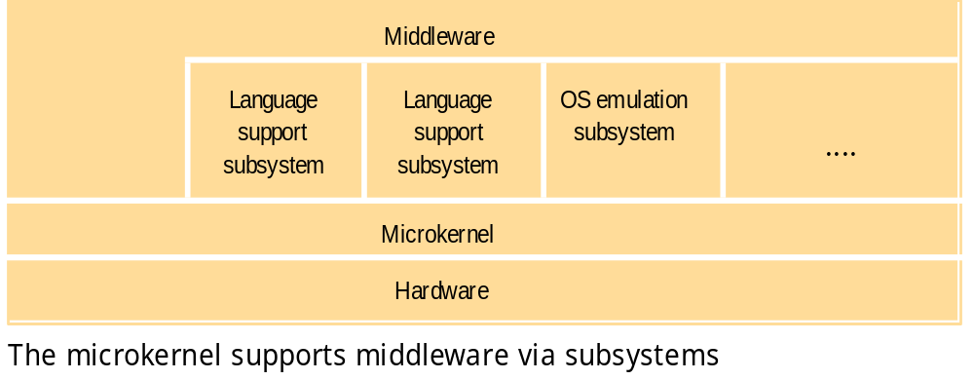
Figure 7.16
The role of the microkernel
Instructor’s Guide for Coulouris, Dollimore, Kindberg and Blair, Distributed Systems: Concepts and Design Edn. 5
© Pearson Education 2012

Slide 36
The microkernel appears as a layer between the hardware layer and a layer consisting of major system components called subsystems.
If performance is the main goal, rather than portability, then middleware may use the facilities of the microkernel directly.
Otherwise, it uses a language runtime support subsystem, or a higher-level operating system interface provided by an operating system emulation subsystem

Slide 37
Comparison
The chief advantages of a microkernel-based operating system are its extensibility and its ability to enforce modularity behind memory protection boundaries.
In addition, a relatively small kernel is more likely to be free of bugs than one that is larger and more complex.
The advantage of a monolithic design is the relative efficiency with which operations can be invoked.
The lack of structure in monolithic designs can be avoided by the use of software engineering techniques such as layering

Slide 38
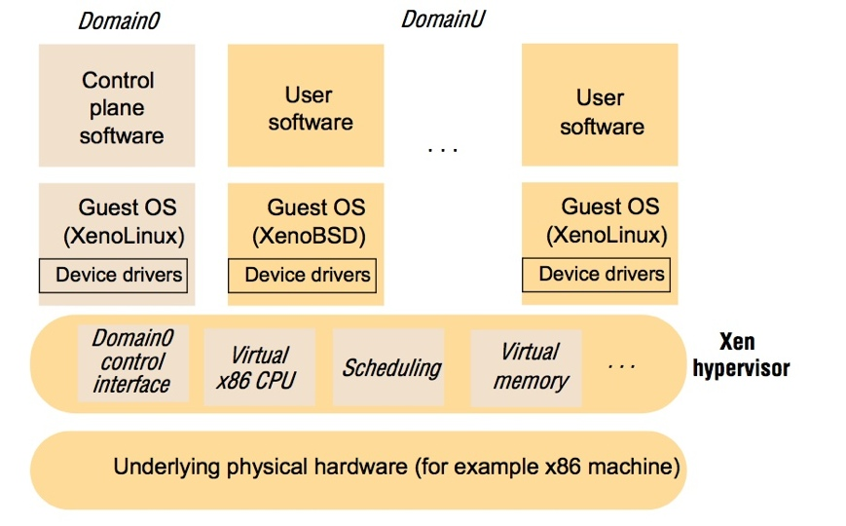
Figure 7.17
The architecture of Xen
Instructor’s Guide for Coulouris, Dollimore, Kindberg and Blair, Distributed Systems: Concepts and Design Edn. 5
© Pearson Education 2012

Slide 39
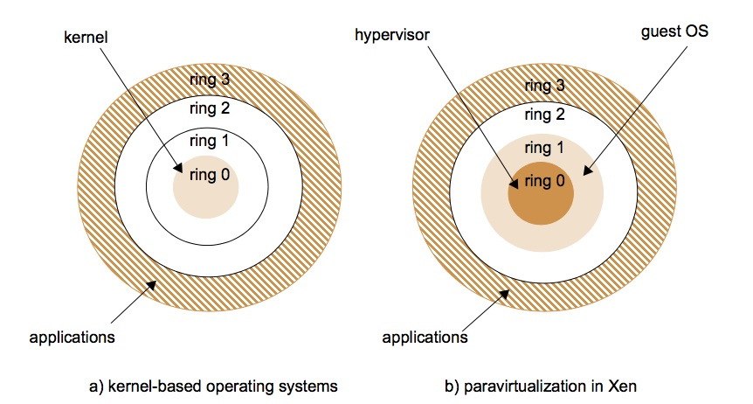
Figure 7.18
Use of rings of privilege
Instructor’s Guide for Coulouris, Dollimore, Kindberg and Blair, Distributed Systems: Concepts and Design Edn. 5
© Pearson Education 2012

Slide 40
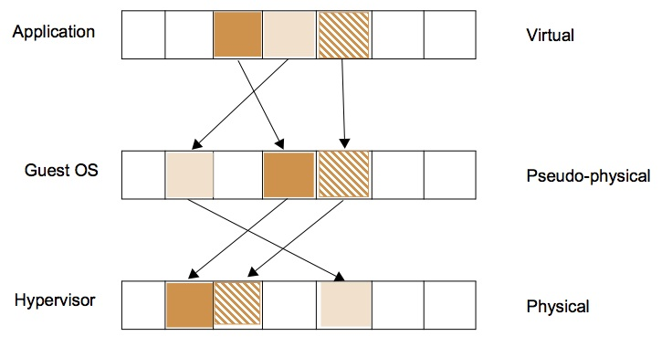
Figure 7.19
Virtualization of memory management
Instructor’s Guide for Coulouris, Dollimore, Kindberg and Blair, Distributed Systems: Concepts and Design Edn. 5
© Pearson Education 2012

Slide 41
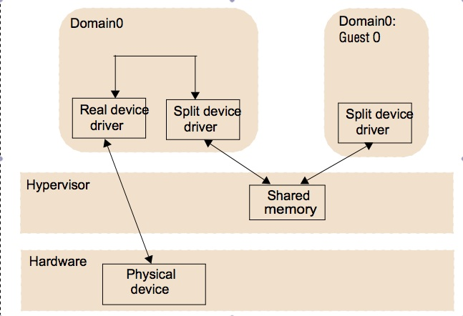
Figure 7.20
Split device drivers
Instructor’s Guide for Coulouris, Dollimore, Kindberg and Blair, Distributed Systems: Concepts and Design Edn. 5
© Pearson Education 2012

Slide 42
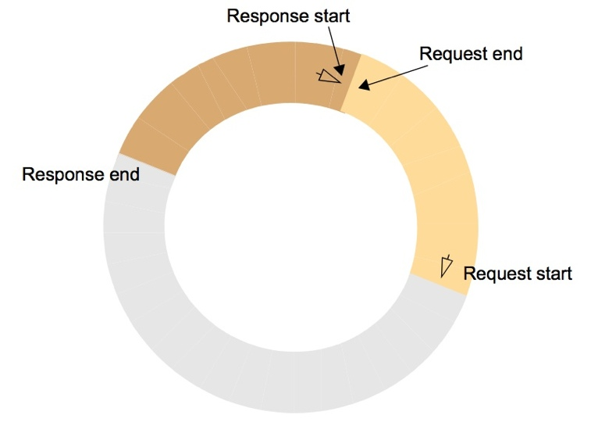
Figure 7.21
I/O rings
Instructor’s Guide for Coulouris, Dollimore, Kindberg and Blair, Distributed Systems: Concepts and Design Edn. 5
© Pearson Education 2012

Slide 43
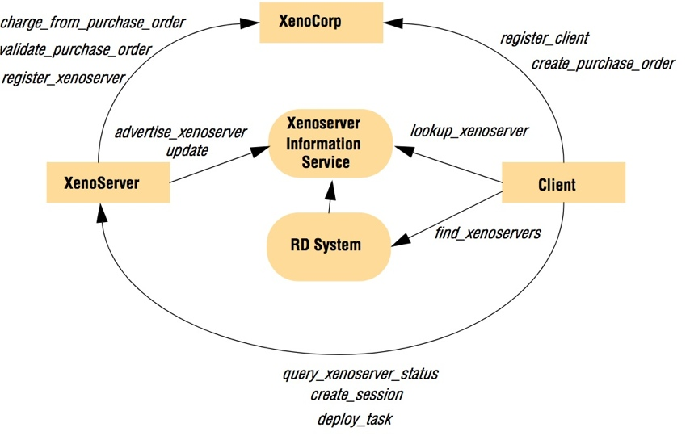
Figure 7.22
The XenoServer Open Platform Architecture
Instructor’s Guide for Coulouris, Dollimore, Kindberg and Blair, Distributed Systems: Concepts and Design Edn. 5
© Pearson Education 2012

Slide 44
Peer-to-peer middleware
Functional requirements:
it must enable clients to locate and communicate with any individual resource made available to a service, even though the resources are widely distributed amongst the hosts.
Other important requirements include the ability to add new resources and to remove them.
peer-to-peer middleware should offer a simple programming interface to application programmers

Slide 45
Non-functional requirements:
Global Scalability: One of the aims of peer-to-peer applications is to exploit the hardware resources of very large numbers of hosts connected to the Internet
Load balancing: The performance of any system designed to exploit a large number of computers depends upon the balanced distribution of workload across them.
Optimization for local interactions between neigh bouring peers: The middleware should aim to place resources close to the nodes that access them the most.

Slide 46
Routing Overlays
In peer-to-peer systems a distributed algorithm known as a routing overlay takes responsibility for locating nodes and objects.
The main task of a routing overlay is the following:
Routing of requests to objects: A client wishing to invoke an operation on an object
submits a request including the object’s GUID to the routing overlay, which routes the request to a node at which a replica of the object resides.
But the routing overlay must also perform some other tasks:
Insertion of objects: A node wishing to make a new object available to a peer-to-peer
service computes a GUID for the object and announces it to the routing overlay, which then ensures that the object is reachable by all other clients.

Slide 47
Deletion of objects: When clients request the removal of objects from the service the routing overlay must make them unavailable.
Node addition and removal: Nodes (i.e., computers) may join and leave the service.
When a node joins the service, the routing overlay arranges for it to assume some of the responsibilities of other nodes. When a node leaves (either voluntarily or as a result of a system or network fault), its responsibilities are distributed amongst the other nodes.

Slide 48
Deletion of objects: When clients request the removal of objects from the service the routing overlay must make them unavailable.
Node addition and removal: Nodes (i.e., computers) may join and leave the service.
When a node joins the service, the routing overlay arranges for it to assume some of the responsibilities of other nodes. When a node leaves (either voluntarily or as a result of a system or network fault), its responsibilities are distributed amongst the other nodes.

Slide 49
Basic programming interface for a distributed hash table (DHT)
put(GUID, data)
Stores data in replicas at all nodes responsible for the object identified by GUID.
remove(GUID)
Deletes all references to GUID and the associated data.
value = get(GUID)
Retrieves the data associated with GUID from one of the nodes responsible for it.

Slide 50
Basic programming interface for distributed object location and routing (DOLR)
publish(GUID)
GUID can be computed from the object (or some part of it, e.g., its name). This function makes the node performing a publish operation the host for the object corresponding to GUID.
unpublish(GUID)
Makes the object corresponding to GUID inaccessible.
sendToObj(msg, GUID, [n])
Following the object-oriented paradigm, an invocation message is sent to an object in order to access it. This might be a request to open a TCP connection for data
transfer or to return a message containing all or part of the object’s state. The final optional parameter [n], if present, requests the delivery of the same message to n
replicas of the object

